Slide 1
Sportsmanship Ideas for Your League
Patrick Brown, AD Squalicum High School | NW Conference
patrick.brown@bellinghamschools.org

Slide 2
Hierarchy of the Sportsmanship Model
State: WIAA-Guidelines, “Just Play Fair”
District: District One-Guidelines and $$$
League: Northwest Conference-Constitution, Education, Application and Cooperation (“Leaders in Sportsmanship” and NWC Sportsmanship Forum)
School: Squalicum High School-Education, Application and Accountability

Slide 3
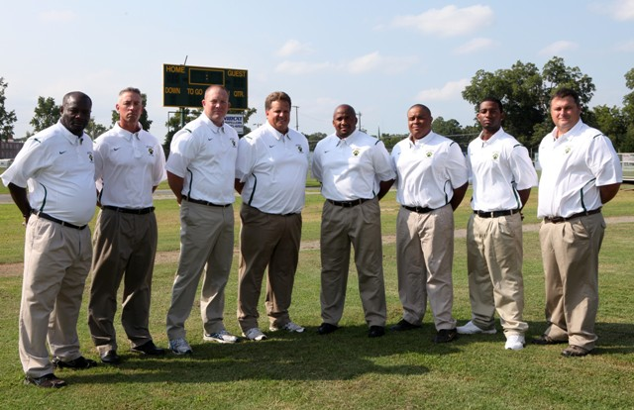
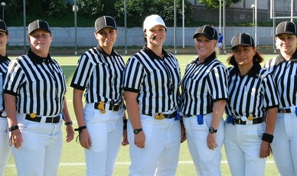
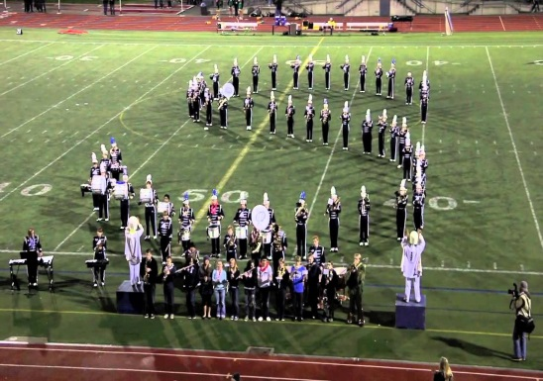
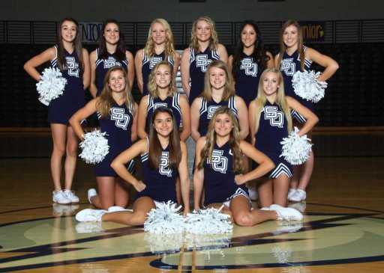
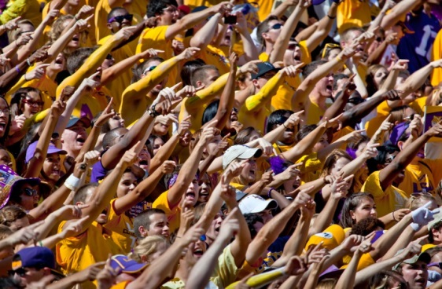
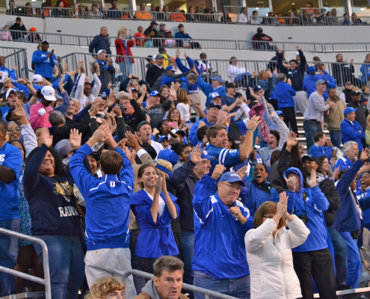
Constituents
Coaches
Officials
Athletes
Sportsmanship
Band
Cheer
Student Section
Parent Section

Slide 4
Challenges
The Message
Lack of Education
Lack of Attention
Administrator Buy In
League Cooperation
Media

Slide 5
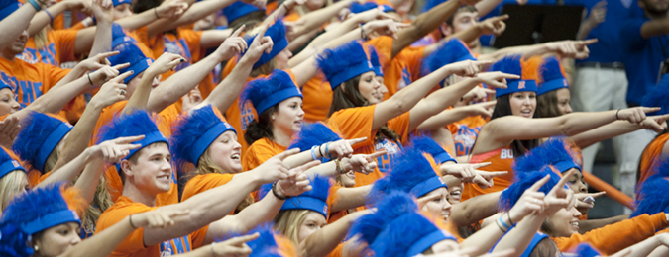
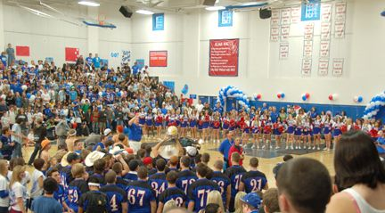
Goals: League and School
School Spirit
Positive Rivalries
Home Field/Court Advantage
Integration: Fans, Cheer Squad and Band
Interleague Cooperation

Slide 6
League Level
Clearly Defined Expectations League Constitution
Sportsmanship Coordinator
Sportsmanship Committee
“Just Play Fair” – Leaders in Sportsmanship
Northwest Conference Sportsmanship Forum
WOA Education/Cooperation
Student Government/Groups

Slide 7
Northwest Conference Sportsmanship Program
“Leaders in Sportsmanship”
Northwest Conference Sportsmanship Forum
Goal: To develop and implement a positive league sportsmanship model. Our ultimate goal is to emphasize positive sportsmanship and character within the overall framework of the public and private school mission.

Slide 8
League Level
Poster Photo Shoot
Recognition Luncheon
T-Shirt
Certificate

Slide 9
Welcome to the 2015-16 Northwest Conference Sportsmanship Forum
One [person] practicing good sportsmanship is far better than 50 others preaching it. Knute K. Rockne

Slide 10
Purpose of the Northwest Conference Sportsmanship Forum:
To develop and implement a positive league sportsmanship model. Our ultimate goal is to emphasize positive sportsmanship and character within the overall framework of the public and private school mission.
Why you!?!
You were selected to attend because of your potential as a student leader. In addition, you were selected to assist in building upon and continuing the positive sportsmanship tradition of the NWC.

Slide 11
Northwest Conference Sportsmanship Program
“Leaders in Sportsmanship”

Slide 12
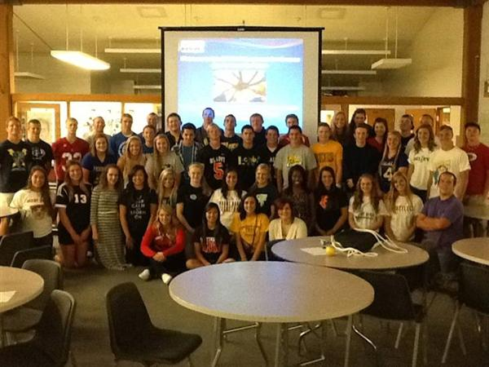
Northwest Conference Sportsmanship Program
Northwest Conference Sportsmanship Forum
Goal: To develop and implement a positive league sportsmanship model. Our ultimate goal is to emphasize positive sportsmanship and character within the overall framework of the public and private school mission.

Slide 13
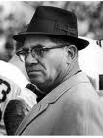
“Winning isn’t everything. It’s the only thing.” Vince Lombardi 1965
Won five NFL titles
Won Super Bowls I and II
Current Super Bowl trophy named in his honor
“I wish to [heck] that I’d never said [that] thing….I meant the effort…I meant having a goal. I sure as [heck] didn’t mean for people to crush human values and morality.”
Vince Lombardi 1970

Slide 14
The Challenge
Notes:
http://www.youtube.com/watch?v=vg7JuVv1hlc&feature=related

Slide 15
Constituents
Coaches
Officials
Athletes
Sportsmanship
Band
Cheer
Student Section
Parent Section

Slide 16
Northwest Conference Sportsmanship Program
The Northwest Conference is strongly committed to sportsmanship and responsible behavior of participants, coaches, cheerleaders, spectators, students and adults, from all member schools. Although many people display appropriate behavior, it is important to teach and re-emphasize sportsmanship and responsible behavior as part of an ongoing program.

Slide 17
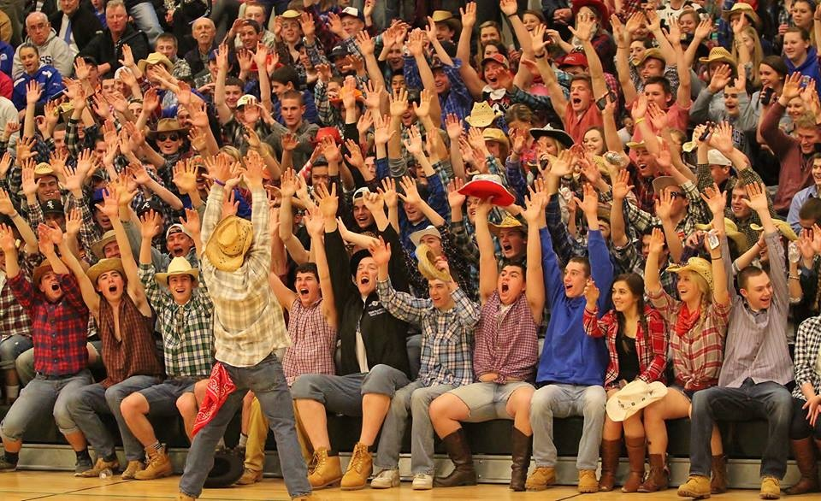
Development Phase One:
How do we define sportsmanship?

Slide 18
“Weakness of attitude becomes weakness of character.” Albert Einstein
Foundations of the NWC Sportsmanship Model
Character Driven
Integrity
Respect
Maturity
Enthusiasm
Responsibility and Accountability
Victory with Honor-Defeat with Dignity
Commitment to Community

Slide 19
When Athletes “Get It”
Notes:
http://www.youtube.com/watch?v=yaXVk5GBx-s&feature=related

Slide 20
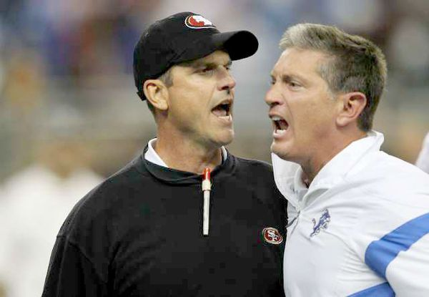
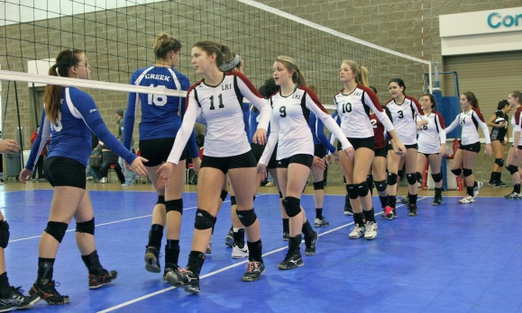
Development Phase Two:
Identify coaches, athletes or fans (at any level) that you have observed demonstrating good or bad character and/or sportsmanship.
Describe specific actions that caused you to think that their behavior was positive or negative.
What character traits are exemplified by these actions?
What was the impact on your school?

Slide 21
When Coaches, Athletes and Fans “Get It”
Notes:
http://www.youtube.com/watch?v=Tui8EOdv_VU&feature=related

Slide 22
Development Phase Three:
As a high school athletic director, you have been asked to make the argument that learning about character and sportsmanship in sports is an important objective of your school’s athletic programs. Outline for parents and community members the points to include in your presentation. (Source: NFHS)
Explain why this is an essential part of your entire athletic program.
How do athletes benefit?
What is the benefit for your school?
What is the benefit for your community?
What is your recommendation on how schools could build character and promote a sportsmanship program?

Slide 23
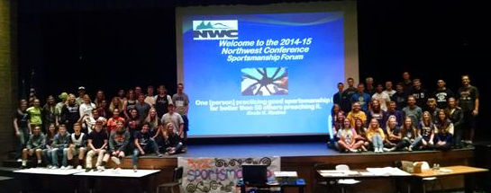
“The strength of the group is the strength of the leaders.”
Vince Lombardi

Slide 24
Development Phase Four:
Evaluate Your School

Slide 25
School Level
Education-Point of Emphasis
Coaches Preseason Meetings
Team Preseason Meetings
Parent Preseason Meetings
Storm Soldiers
Cheer Squad
Band
Game Management - Administrator Buy In
Culture of Excellence

Slide 26
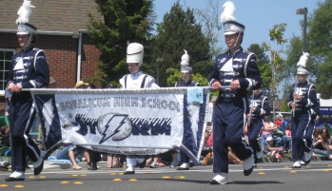
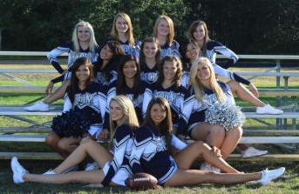
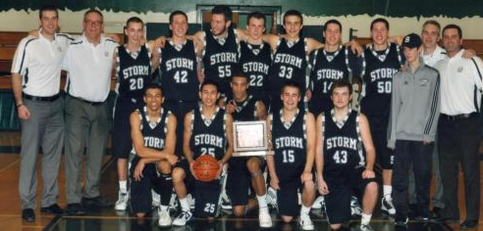
Sportsmanship Ideas for Your League
Patrick Brown, AD Squalicum High School | NW Conference
patrick.brown@bellinghamschools.org

